Slide 1
Distribution to Shareholders
Concept and types of dividends;
Factors affecting dividend policy;
Dividend payment procedures;
Dividend policy in practice:
Stability in dividends and Residual dividend policy
Stock dividends,
Stock splits,
Reverse stock splits;
Stock repurchases;
Dividend payment practices in Nepal

Slide 2
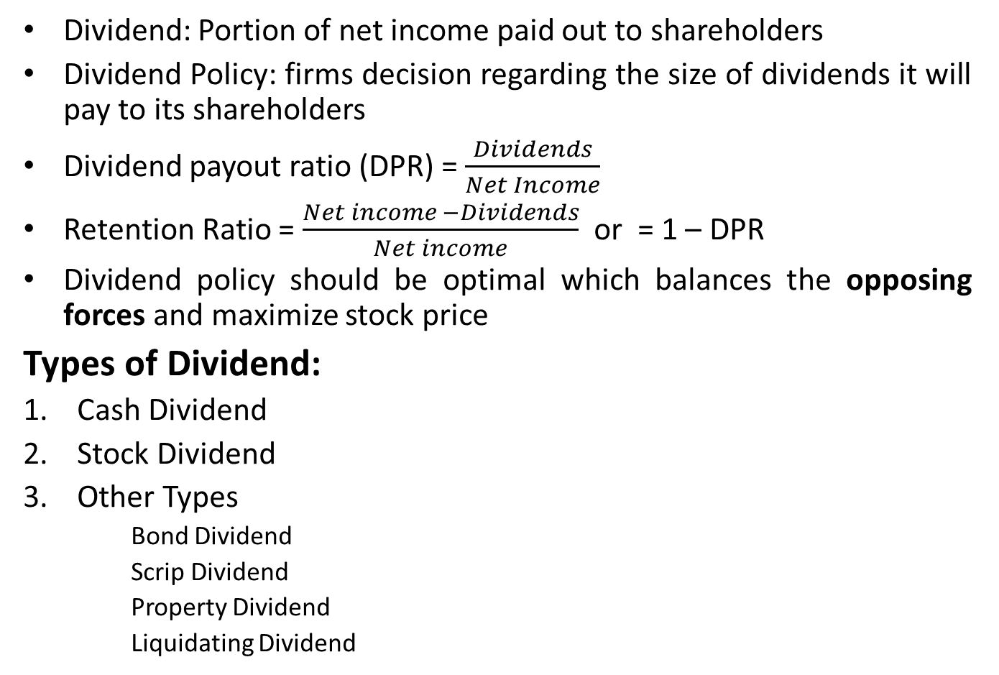
Concept and Types of Dividend
Dividend: Portion of net income paid out to shareholders
Dividend Policy: firms decision regarding the size of dividends it will pay to its shareholders
Dividend payout ratio (DPR) = $\frac{Dividends}{Net Income}$
Retention Ratio = $\frac{Net income −Dividends}{Net income}$ or = 1 – DPR
Dividend policy should be optimal which balances the opposing forces and maximize stock price
Types of Dividend:
Cash Dividend
Stock Dividend
Other Types
Bond Dividend
Scrip Dividend
Property Dividend
Liquidating Dividend

Slide 3
Factors Affecting Dividend Policy
Size of earnings
Liquidity Position
Legal rules
Desire of shareholders
Need to repay debt
Restrictions in debt contacts
Rate of asset expansion
Profit rate
Stability of earning
Tax position of shareholders
Control
Access to the capital Market

Slide 4
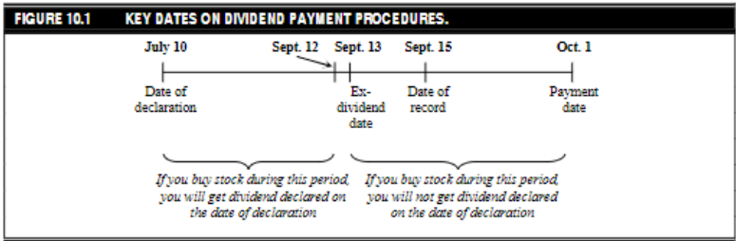
Dividend Payment Procedures

Slide 5
Dividend Policy in Practice
Firms establish dividend policy within framework of their overall financial plan
Forecast of financial and investment needs
Target capital structure which minimize WACC
Estimation of debt and equity plan
Long-term payout ratio is determined
Actual dividend is decided
Types of Dividend Policy
Stability in Dividends
Residual Dividend Policy

Slide 6
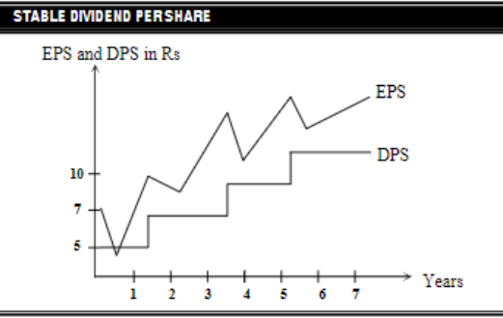
Stability in Dividends
Stability means maintaining its position in relation to a trend preferably one that is upward sloping
1. Stable Dividend Per Share
Constant Rs per share is paid as dividend irrespective of earning
However it does not mean DPS remain fixed for all periods, DPS is likely to increase over a year and firm try to maintain the dividend stable again

Slide 7
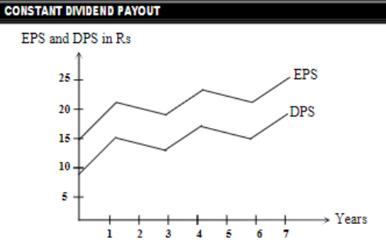
Stability in Dividends
2. Constant Payout Ratio
Fixed percentage of earning is paid as dividend every period
Rupee amount of dividend may fluctuate but DPR will remain constant
3. Low Regular Dividend Plus Extras
Compromise between stable dividend and constant payout rate
Gives flexibility to firm yet investors can count on receiving at least a minimum dividend
Suitable when earning is volatile

Slide 8
Residual Dividend Policy
Suggest that firm should retain its earning as long as it has investment opportunities that promise higher return than shareholders required rate of return
Investors are paid as dividend only after meeting its investment need at desired debt-equity ratio
Would follow following four steps:
Determine optimal capital budget
Determine amount of equity required to preserve optimal capital structure
Use retained earnings to supply equity required as far as possible
Pay dividend if earning are available than are needed to support the optimal capital budget
Dividends= Net Income – (Target equity ratio × Total capital budget)
Example Problem 1: Janakpur Corporation expected net income for next year is Rs 1 million. The company target and current structure is 40 percent debt and 60 percent common equity. The optimal capital budget for the next year is Rs 1.2 million. If Janakpur uses residual theory of dividends, what is the amount of dividends and dividend payout ratio?

Slide 9
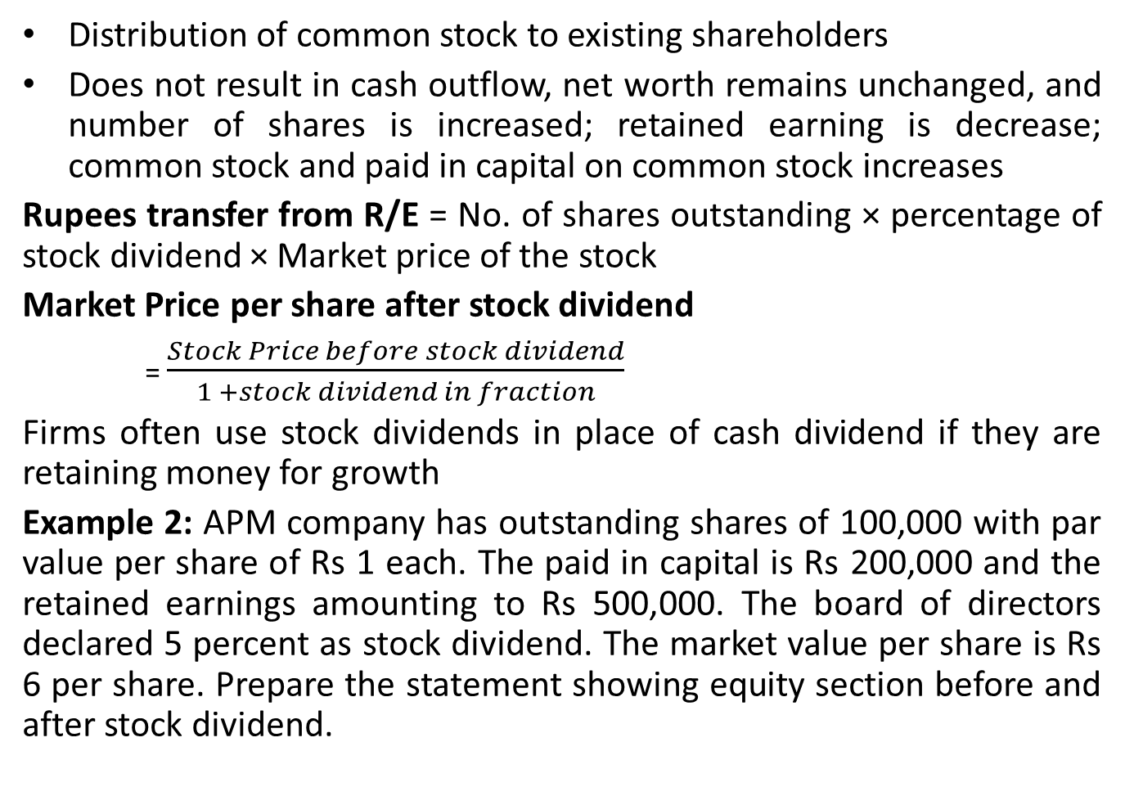
Stock Dividend
Distribution of common stock to existing shareholders
Does not result in cash outflow, net worth remains unchanged, and number of shares is increased; retained earning is decrease; common stock and paid in capital on common stock increases
Rupees transfer from R/E = No. of shares outstanding × percentage of stock dividend × Market price of the stock
Market Price per share after stock dividend
= $\frac{Stock Price before stock dividend}{1 +stock dividend in fraction}$
Firms often use stock dividends in place of cash dividend if they are retaining money for growth
Example 2: APM company has outstanding shares of 100,000 with par value per share of Rs 1 each. The paid in capital is Rs 200,000 and the retained earnings amounting to Rs 500,000. The board of directors declared 5 percent as stock dividend. The market value per share is Rs 6 per share. Prepare the statement showing equity section before and after stock dividend.

Slide 10
Stock Splits
An action taken by a firm to increase the number of shares outstanding by reducing the par value of the stock
Company may double, triple, quadruple number of share outstanding, market price is lowered; economic reality does not change at all.
Purpose: Enhance the marketability of shares bringing it within optimal price range
Example 3: CPM company has outstanding shares of 100,000 with a par value per share of Rs 10 each. The paid on capital is Rs 1,000,000 and the retained earnings amounting to Rs 1,000,000. The board of directors declares 2 for 1 stock splits. The market value per share is Rs 6 per share. Prepare the statement showing the equity section before and after change.

Slide 11
Reverse Stock Split
Stock split in which number of shares outstanding is reduced
Effects: decrease number of shares outstanding; increase in par value; increase in market price; total net worth remain unchanged
Reverse split is used to stop market price per share below certain level
Example 4: JPM Company has outstanding shares 100,000 with a par value per share of Rs 10 each. The paid in capital is Rs 1,000,000 and the retained earnings amounting to Rs 1,000,000. The board of directors declares 1 for 2 stock splits. The market value per share is Rs 6 per share. Prepare the statement showing the equity section before and after the reverse split.

Slide 12
Stock Repurchase
Buying back its own shares by the company from the markets
Stocks repurchased by the company are called Treasury Stocks
Motives for stock repurchase:
Retire share and reduce number of outstanding shares
Acquire share and make available for employee stock option plan
Increase shareholders value (if earning of company remain constant)
Tax benefits for some shareholders
Stock repurchase for retirement, main motive is to distribute excess cash to shareholders and similar to cash dividend
Advantage of stock repurchase: Increase earning per share and tax benefits to the stockholders

Slide 13
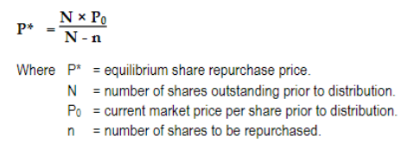
Stock Repurchase
Equilibrium Formula:
Capital gain resulted from repurchase should be equal to the cash dividend otherwise would have to be paid.
If offer price is greater than equilibrium repurchase price, the stock holders who tender their share would gain and the others who continue would lose. In reverse condition, the stockholders tendering their share would lose.

Slide 14
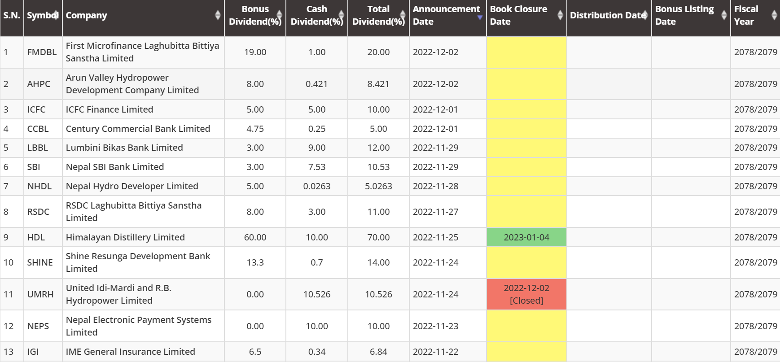
Dividend Payment Practices in Nepal

